Slide 1


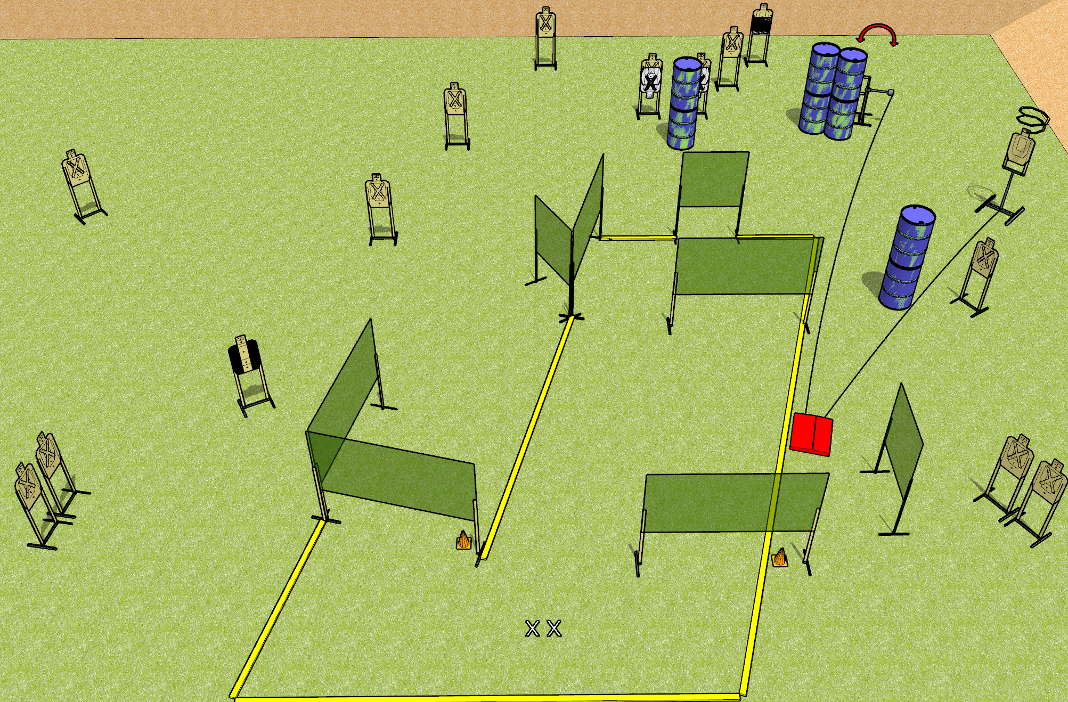
 | Dothan Gun Club – USPSA Match I Got Nothing Course Designer : Drew Coleman
START POSITION : Standing with both feet on X’s, wrists below belt
GUN READY CONDITION : Pistol loaded and holstered. PCC loaded, held with both hands, shouldered, safety on, pointed at orange cone. |  | SCORING: Comstock, 32 rounds TARGETS: 16 paper, 0 Steel SCORED HITS: Best 2 on paper, steel until down START-STOP: Audible, last shot RULES: Drop turner is a disappearing target
STAGE PROCEDURE: Engage targets as they become available from within the fault lines.

Slide 2
I Got Nothing
Written Stage Briefing
I Got Nothing is a 32 round, 160 point, Comstock field course. There are sixteen USPSA targets. The best two hits on paper will score. The start signal is audible.
The drop turner and swinger are both activated by the stomp pad. The drop turner is a disappearing target, and the swinger is visible at rest. Please check the activators before walkthrough and set them the same way every time.
Handgun start position is standing with both feet on X’s, wrists below belt. Handgun is loaded and holstered.
PCC start position is standing with both feet on X’s, muzzle pointed at orange cone. Loaded carbine is held with both hands, safety on, shouldered.
On start signal engage targets as they become available from within the shooting area.

